Slide 1
Friction
Chapter 4

Slide 2
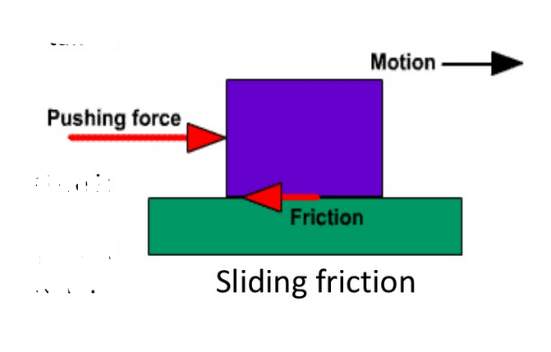
The opposing force, which acts in the opposite direction of the movement of the block, is called force of friction or simply friction.

Slide 3
Type of friction
1.Dry friction/Coulomb Friction
2.Fluid Friction

Slide 4
Fluid friction
Develop between two layers of fluid , moving at different velocities.
Fluid friction is that force which resist the motion either within the fluid itself or of another medium moving through the fluid.

Slide 5
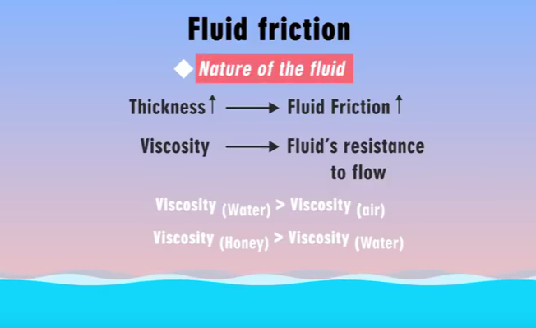

Slide 6
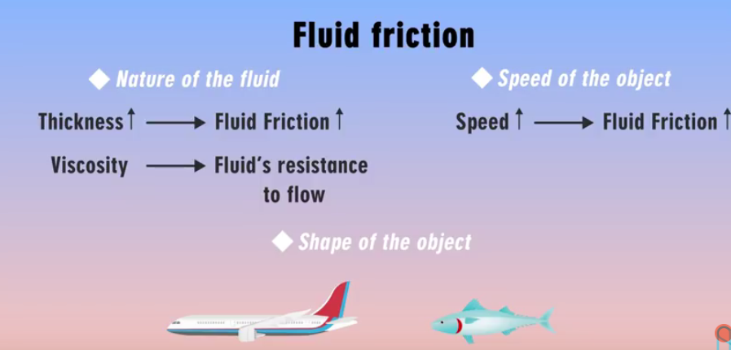


Slide 7
Dry friction/Coulomb Friction
The friction developed between two bodies having dry contact surface.
Major causes of dry friction are:
Roughness of surface of contact
Intermolecular attraction etc.

Slide 8
Type of dry friction
1.Static friction
2.Dynamic Friction
friction experienced by a body when it is at rest
Or in other words, it is the friction when the body tends to move.
It is the friction experienced by a body when it is in motion
also called kinetic friction.

Slide 9
Effects of friction
Associated with energy dissipation.
Mechanical energy converted to heat energy.

Slide 10
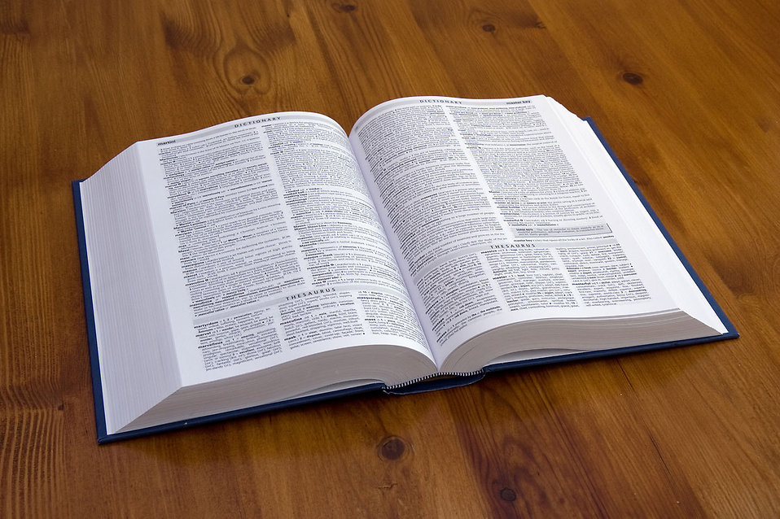

Static Friction
Static friction is friction that occurs when the surfaces in contact are at rest (not in motion).
Examples:
A book resting on a desk.
A plant on a table.

Slide 11
Static friction:
The opposing force that comes into play when one body tends to move over the surface of another, but the actual motion has yet not started is called static friction.

Slide 12
Dynamic Friction
Two type
2.Rolling friction
1.Sliding friction

Slide 13


Sliding Friction
Sliding friction is friction that occurs when solid surfaces slide over one another.
Examples:
Writing – pencil point and paper
Combing your hair – surface of comb and strands of hair

Slide 14


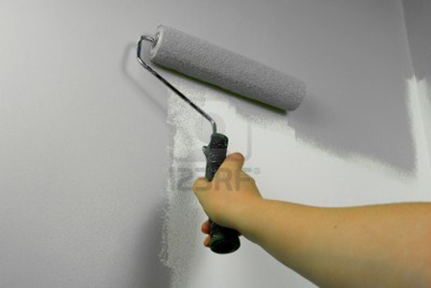
Rolling Friction
Rolling friction is friction that occurs between surfaces in motion in which one of the surfaces is a wheel, roller, or ball.
Examples:
Driving a car – tires and road
Bowling – ball and lane

Slide 15
Limiting Friction
The frictional force is just sufficient to prevent motion up to a certain limit, hence the name LIMITING FRICTION.
The limiting frictional force is proportional to the normal reaction (pressure with which the surfaces are forced together) between the bodies in contact.

Slide 16
Limiting friction
On increasing external force(P) , static friction forces(F) also increases.
If the applied force exceeds a certain(maximum) value, the body starts moving.
This maximum value of static friction up to which body does not move is called limiting friction.

Slide 17
Impending motion
When an object is just about to slip from any surface then the state of the object is known as impending motion. When the static friction reaches its maximum limit then the impending motion occurs.
The mathematical formula of the impending motion is F=μsN.

Slide 18
Example:

Slide 19
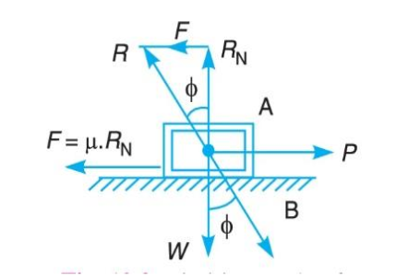
Angle of friction
The angle between normal reaction (N/RN) and resultant (R) of friction force with the normal reaction is called angle of friction (∅).
/ N

Slide 20
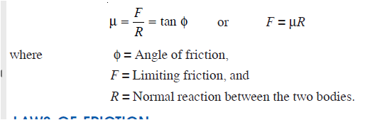
COEFFICIENT OF FRICTION
It is the ratio of limiting friction to the normal reaction, between the two bodies, and is generally
Denoted by μ.
Mathematically, coefficient of friction,

Slide 21
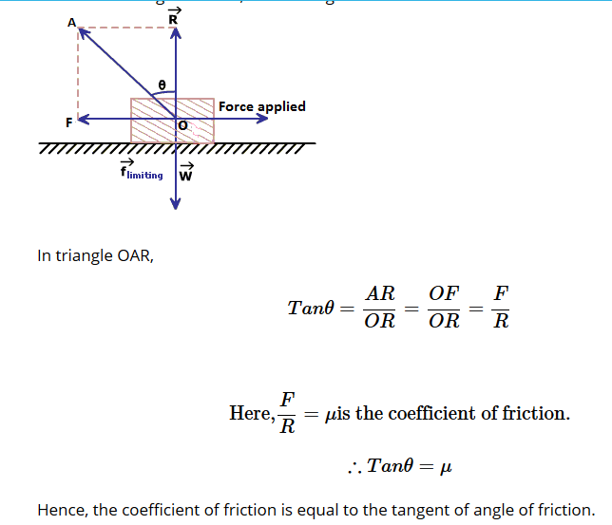
R /
/ N

Slide 22
Laws of friction(Dry friction)
The force of friction acts in the opposite direction in which surface is having tendency to move.
The force of friction is equal to the force applied to the surface, so long as the surface is at rest.
When the surface is on the point of motion , the force of friction is maximum and this maximum frictional force is called the limiting frictional force.

Slide 23
5.The limiting frictional force does not depend upon the shape and area of surfaces in contact.
6.The ratio between limiting friction and normal reaction is slightly less when the two surfaces are in motion.
7.The force of friction is independent of the velocity of sliding which happens in the cases of low velocities.

Slide 24
4. The force of friction is independent of the area of contact between the two surfaces.
5. The force of friction depends upon the roughness of the surfaces.

Slide 25
Static Friction, it’s coefficient and angle
Let W be the weight of the block.
Let N be the normal reaction.
If force P is applied gradually, the frictional force also increases until it reaches its maximum limit Fs(i.e static frictional force)
If P is increased furthers cant balance the block any more and the block starts moving.
Once the block is set in motion Fs drops to fk(i.e kinetic friction force).

Slide 26
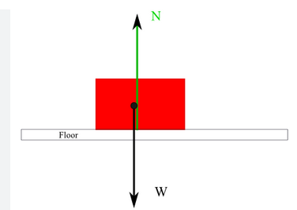
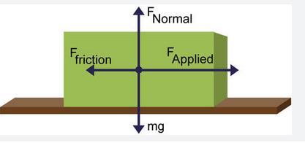
Fig a. No friction
Fig b. Friction

Slide 27
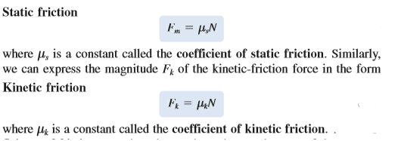
Static Friction, it’s coefficient and angle
s

Slide 28

From experiments:
Note: $μ_{k} is about 25\% smaller than μ_{s}$.

Slide 29
Condition of no friction , no motion , impending motion and motion.

Slide 30
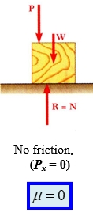
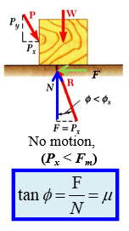
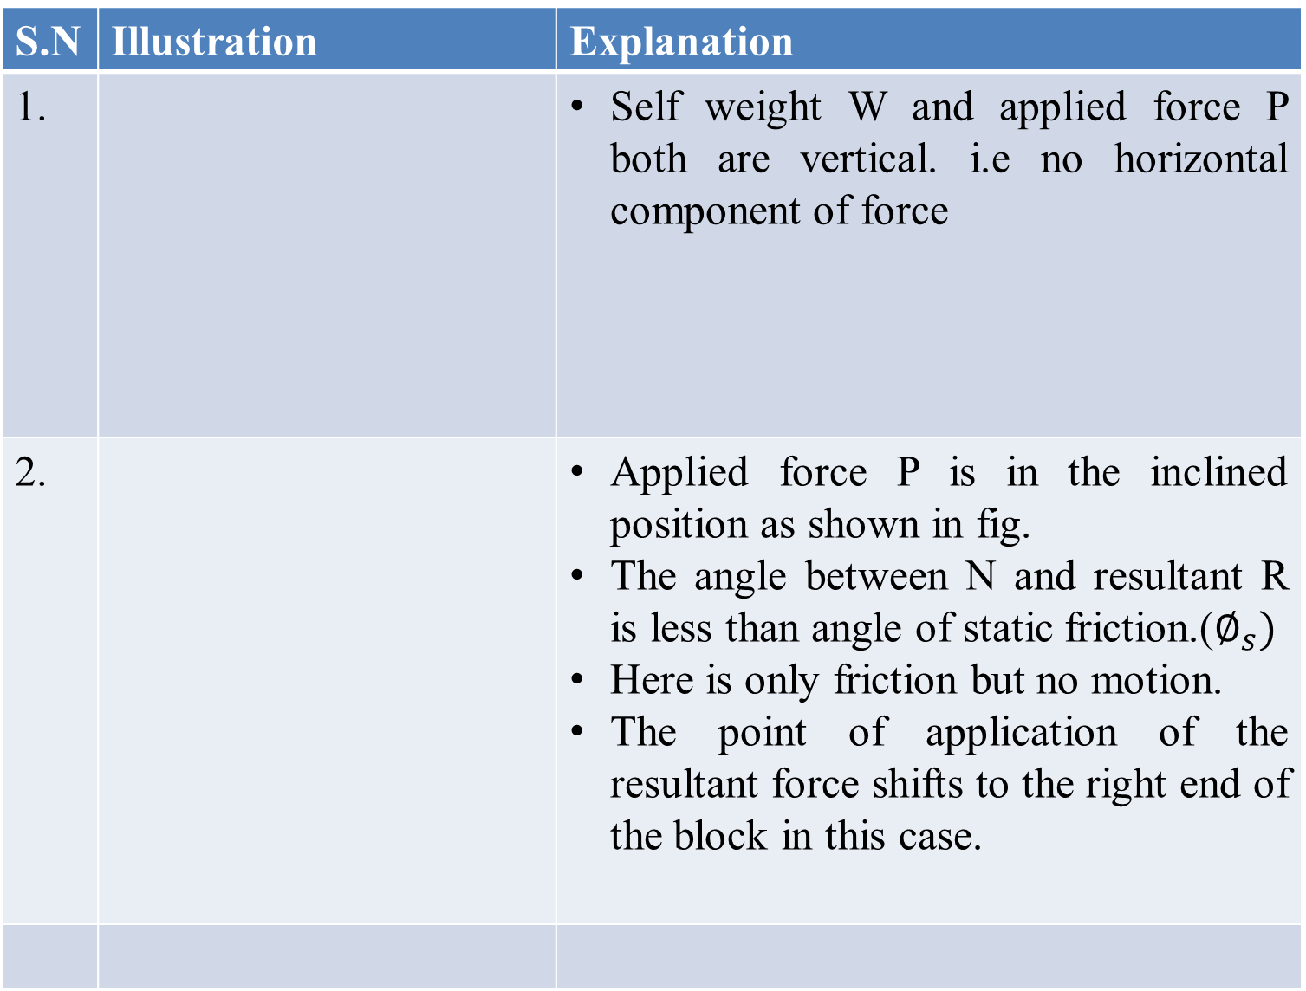
z
S.N | Illustration | Explanation
1. |  | Self weight W and applied force P both are vertical. i.e no horizontal component of force
2. |  | Applied force P is in the inclined position as shown in fig. The angle between N and resultant R is less than angle of static friction.($∅_{s})$ Here is only friction but no motion. The point of application of the resultant force shifts to the right end of the block in this case.

Slide 31
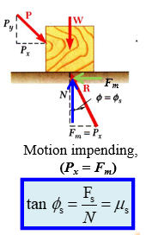
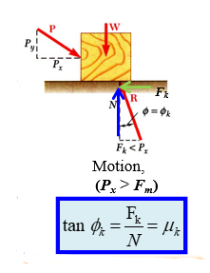
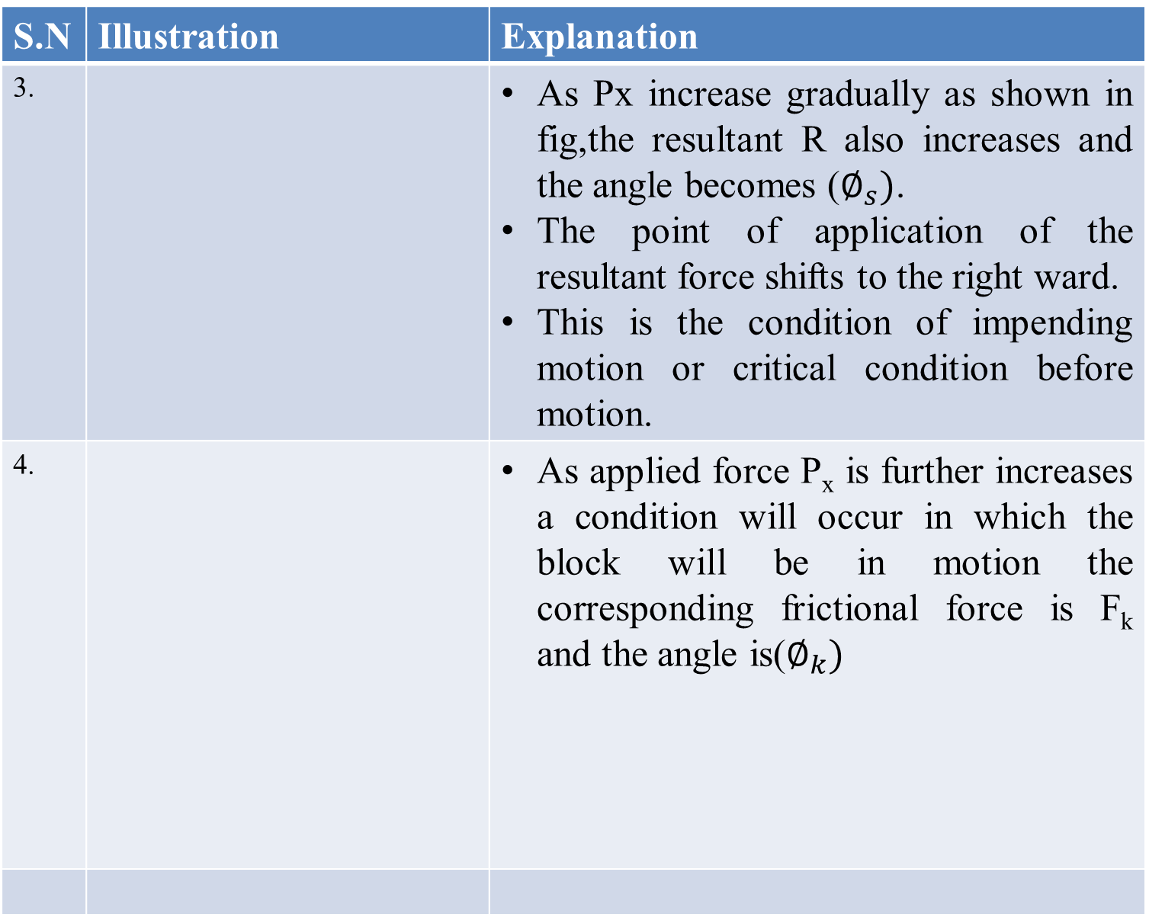
S.N | Illustration | Explanation
3. |  | As Px increase gradually as shown in fig,the resultant R also increases and the angle becomes ($∅_{s})$. The point of application of the resultant force shifts to the right ward. This is the condition of impending motion or critical condition before motion.
4. |  | As applied force P_{x} is further increases a condition will occur in which the block will be in motion the corresponding frictional force is F_{k} and the angle is($∅_{k})$

Slide 32
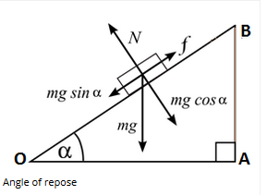
Angle of repose
The angle made by the inclined plane with horizontal such that the body just begin to slide is called angle of repose. In figure below, α is the angle of repose.

Slide 33
Condition of tipping and sliding of a block
As the magnitude of frictional force (F),increases from 0 to Fs, the point of application of the resultant (R) moves towards the right end of the block.
Couples formed by P,F,W and N remain balanced.
If R reaches B(end of block) before reaches its maximum value(Fs or Fm), the block will tip about B before sliding.

Slide 34
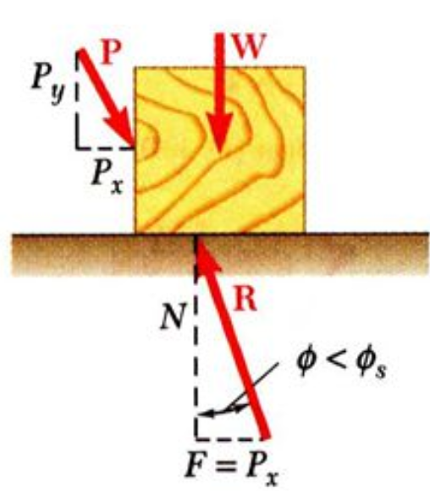

Slide 35
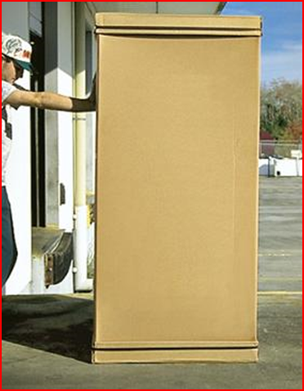
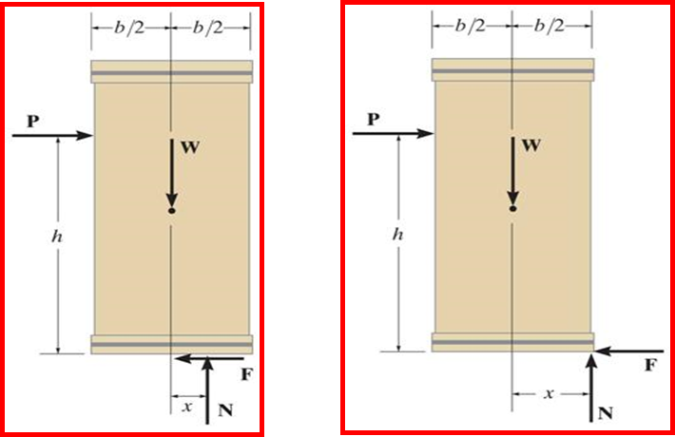
Condition of tipping and sliding
Fig a. Sliding Fig b. Tipping

Slide 36
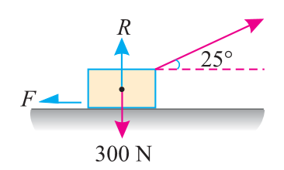
Numericals
A body of weight 300 N is lying on a rough horizontal plane having a coefficient of friction as 0.3. Find the magnitude of the force, which can move the body, while acting at an angle of 25° with the horizontal.

Slide 37
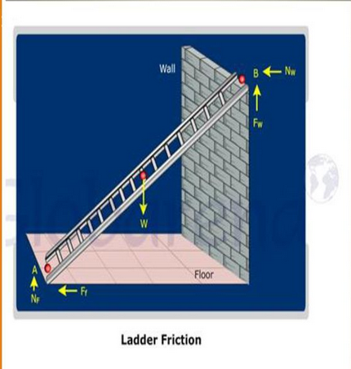
Application :
Ladder friction

Slide 38
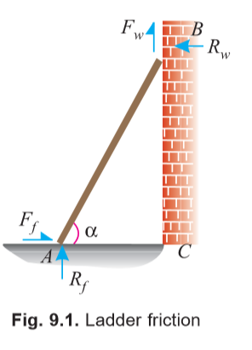

Slide 39
Consider a ladder AB resting on the rough ground and leaning against a wall, as shown in Fig. 9.1.
As the upper end of the ladder tends to slip downwards, therefore the direction of the force of friction between the ladder and the wall (Fw) will be upwards as shown in the figure.

Slide 40
Similarly, as the lower end of the ladder tends to slip away from the wall, therefore the direction of the force of friction between the ladder and the floor (Ff) will be towards the wall as shown in the figure.
Since the system is in equilibrium, therefore the algebraic sum of the horizontal and vertical components of the forces must also be equal to zero.

Slide 41
Note:
The normal reaction at the floor (Rf) will act perpendicular of the floor.
Similarly, normal reaction of the wall (Rw) will also act perpendicular to the wall.

Slide 42
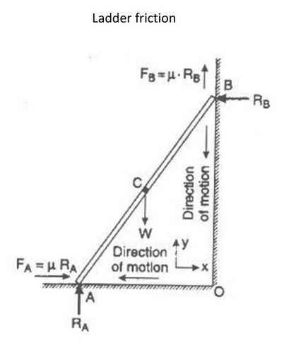

Slide 43
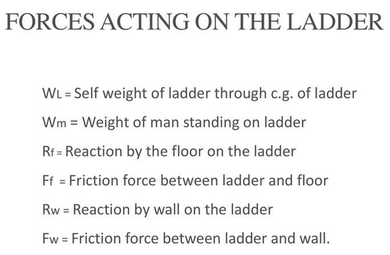

Slide 44
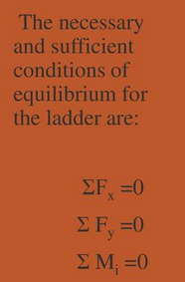

Slide 45
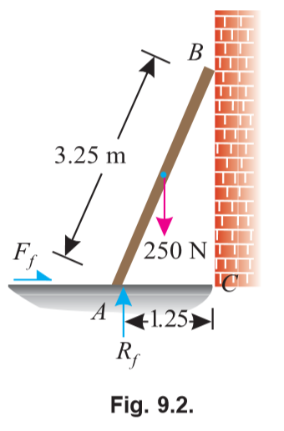
A uniform ladder of length 3.25m and weighing 250 N is placed against a smooth vertical wall with its lower end 1.25m from the wall.The coefficient of friction between the ladder and floor is 0.3.What is the frictional force acting on the ladder at the point of contact between the ladder and floor?Show that the ladder will remain in equilibrium in this position.

Slide 46
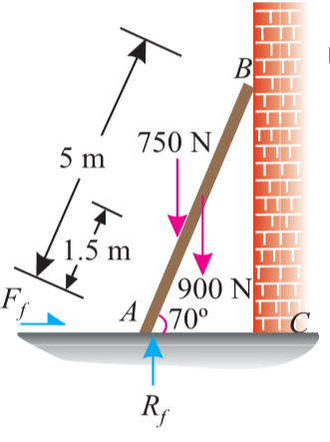
A ladder 5m long rests on a horizontal ground and lean against a smooth vertical wall at an angle 70 degree with the horizontal. The weight of the ladder is 900 N and acts at its middle. The ladder is at the point of sliding, when a man weighing 750 N stands on a rung 1.5 m from the bottom of the ladder. Calculate the coefficient of friction between the ladder and the floor.

Slide 47
Block friction
Problem on block friction(horizontal plane)
Problem on block friction(incline plane)

Slide 48
Problems on block friction(horizontal plane)
Block(horizontal plane)
Free body Diagram
Frictional force
Condition of equilibrium
Unknown
Normal Reaction

Slide 49
Problems on block friction(inclined plane)
Block(inclined plane)
Free body Diagram
Frictional force
Condition of equilibrium
Unknown
Normal Reaction

Slide 50
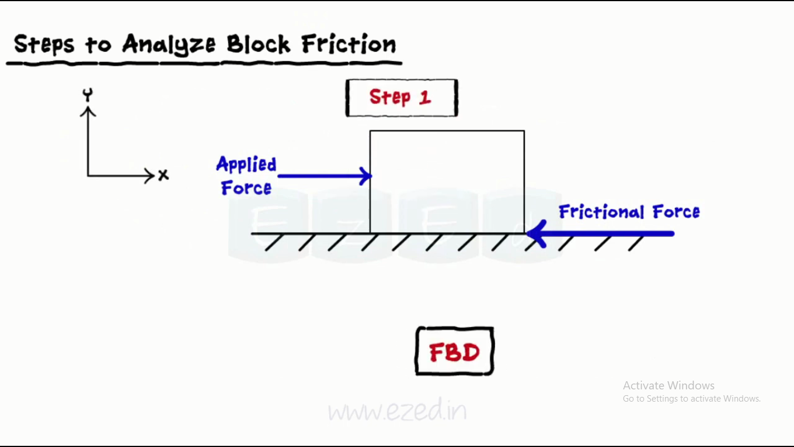
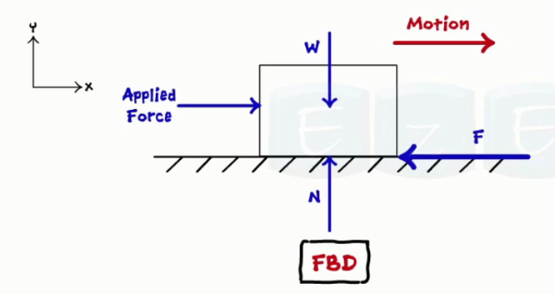
Steps to analyze block friction(horizontal plane): Step 1:
Free body diagram.

Slide 51
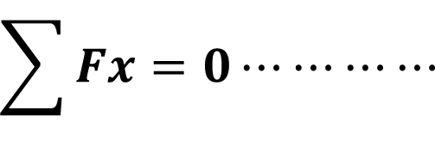
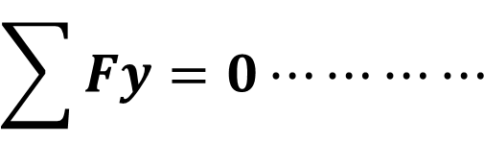
Step 2:Concurrent system
$$\sum{Fx=0⋯⋯⋯⋯ }$$
+ve
$$\sum{Fy=0⋯⋯⋯⋯ }$$
+ve

Slide 52
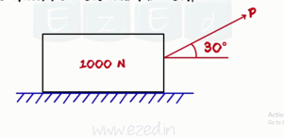
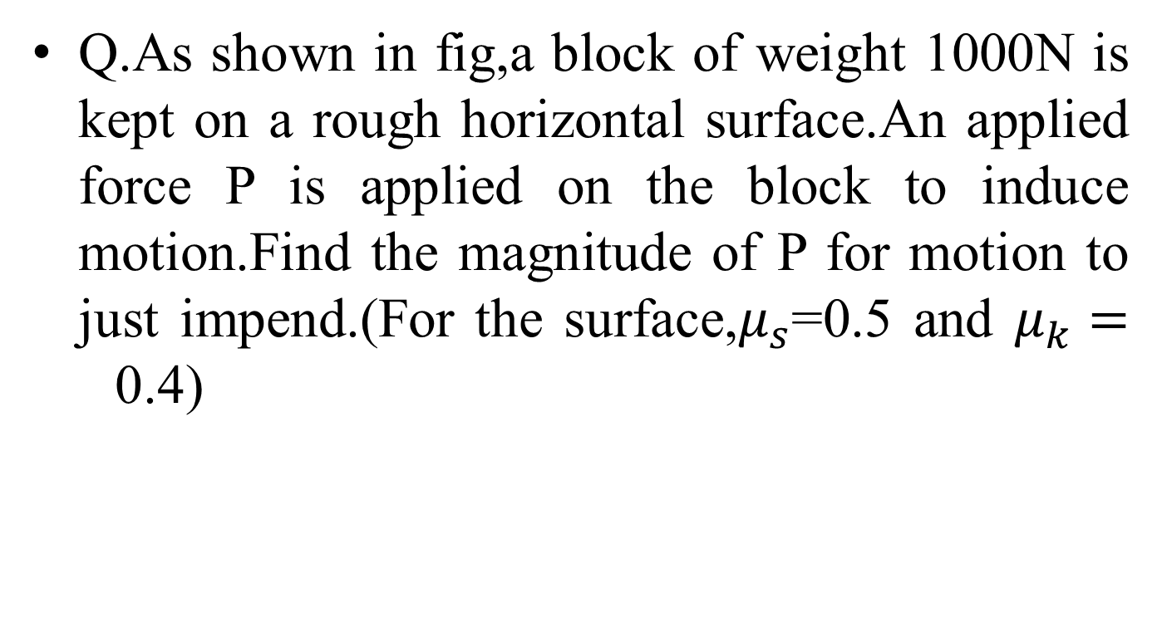
Q.As shown in fig,a block of weight 1000N is kept on a rough horizontal surface.An applied force P is applied on the block to induce motion.Find the magnitude of P for motion to just impend.(For the surface,$μ_{s}$=0.5 and $μ_{k}=$0.4)

Slide 53
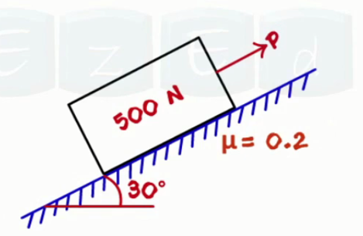
Q.As shown in the figure, a 500 N block is placed on an inclined plane. A force P is applied to the block to keep it in equilibrium, this force is applied parallel to the inclined plane. Determine the range of values of applied force, P in which the block will be in equilibrium.

